Slide 1


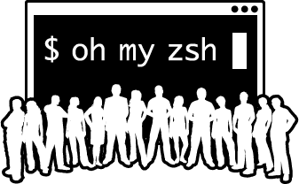
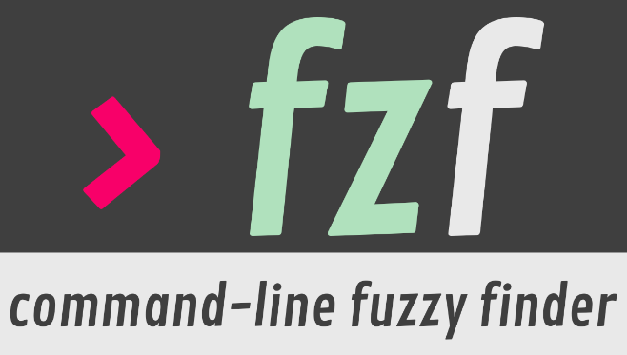


Putting together the perfect terminal experience
The relatively short version

Slide 2


Who am I?
Aspiring Speakers Group member #1
I have a cute accent
I spend a lot of time using the terminal
Principal Developer at Comply Advantage
Disclaimer: Nothing that I say or do has anything to do with my employer:
But we are hiring
https://complyadvantage.com/careers/

Slide 3

Motivation
I’m a IntelliJ IDEA kind of person
Keyboard shortcuts are ❤️
Thanks to the whole DevOps movement I’m expending more and more time using the terminal
Old school SysAds surely can do a lot in the terminal
Can I become more productive with the terminal?
https://www.youtube.com/watch?v=41CC-F6KRP8

Slide 4
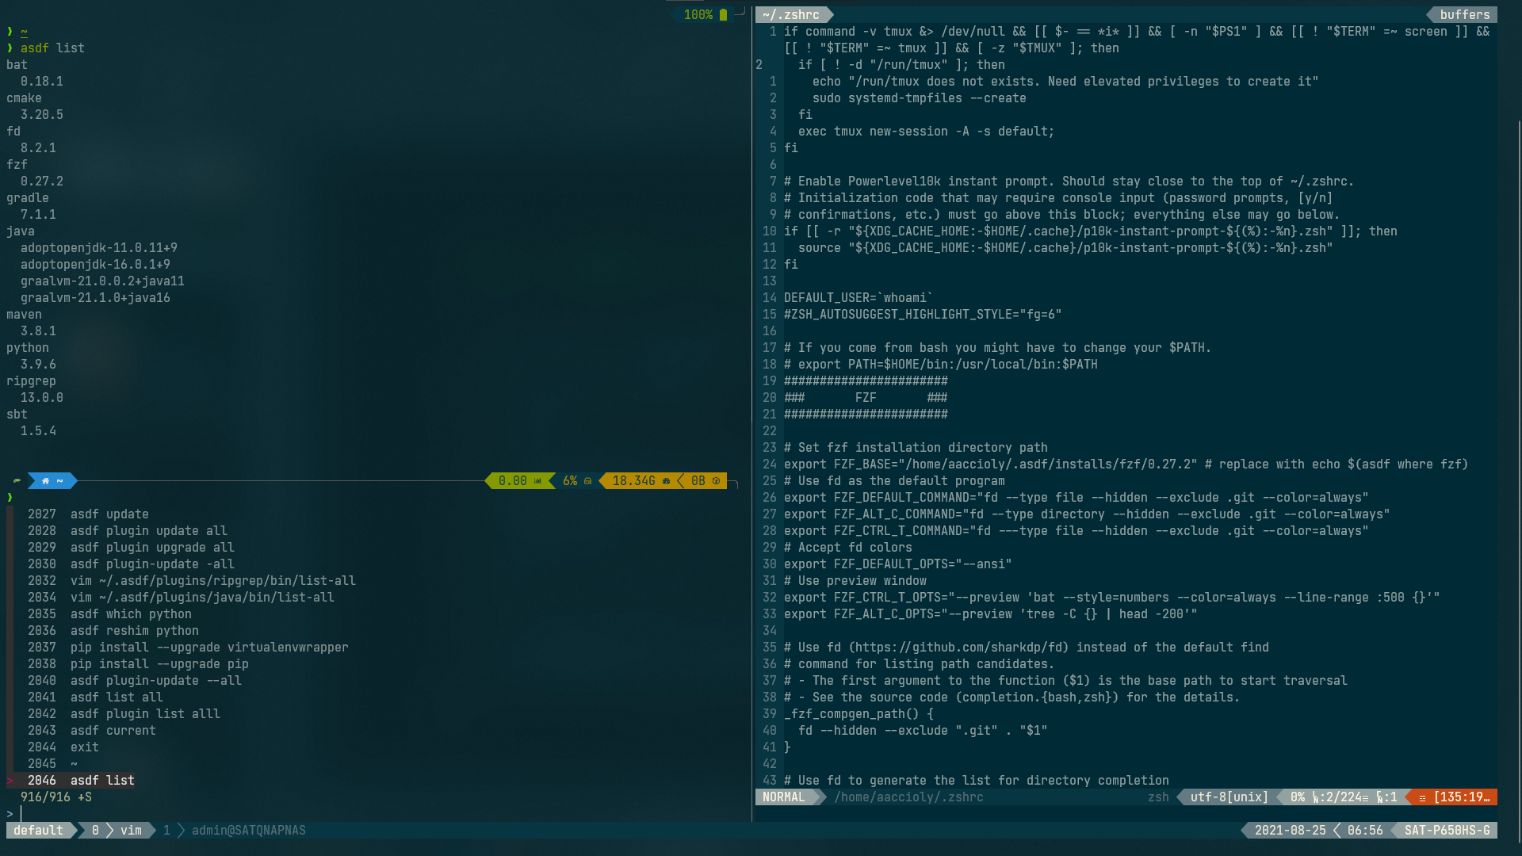
So, what’s the “perfect” terminal experience?
It’s up to you. My wishlist:
And it looks like this:
Terminal doesn’t get in my way
Fast
Low energy consumption
Syntax highlighting and auto-completion
I can quickly find files, commands, etc
Term can handle context switching
It remembers what I was doing 3 days ago so that I don’t have to do it

Slide 5





Let’s get something out of the way
+
I will be using Ubuntu Today
This is not a talk for Linux Gurus
The OS itself isn’t as important as you may think
I’ll be using a terminal emulator called kitty:
https://sw.kovidgoyal.net/kitty/
Your choice of terminal emulator is important
Pick one that:
  Is GPU Accelerated
  Has a Quake / drop-down mode
  Has good font support (including ligatures)
+
+

Slide 6

Eye Candy:
Fonts
Colours
You want a Monospaced font
At least Powerline Glyphs
Optional: Font ligatures
Pick one from https://www.nerdfonts.com/:
  JetBrains Mono
  Cascadia Code
  Fira Code
  Meslo
  Source Code Pro / Hasklig
  Ubuntu Mono
Pick a colour scheme that doesn’t make your eyes bleed
I don’t have a lot of imagination, so I keep coming back to my own patched version of Solarized Dark
A few other suggestions:
  Base16 schemes: https://github.com/chriskempson/base16
  Dracula
  Gruvbox
  Monokai
  PaperColor

Slide 7

Shell
Bash is great, Zsh is even better
Install a recent version and make it default:
chsh -s $(which zsh)
Notable features:
  Smart tab completion
  History filter with up arrow
  case / typo correction
  ** expansion
  Glob Qualifiers: ls *(m-7)

Slide 8

Framework / Plugin Managers
Extract even more from zsh with a collection of plugins and themes. Use Oh My Zsh
Install Oh My Zsh and start enjoying extra functionality out of the box:
  Easier nagivation:
    .. , …, ….
    No need to type cd
    Partial path matching
  New commands / alias by default such as:
    d / cd -N
    rd
    take
Install custom plugin sand edit your .zshrc file to enable / disable plugins
  zsh-autosuggestions
  zsh-syntax-highlighting
  z
  web-search
If you are using too many plugins and your shell is taking a while to start, have a look at a plugin manager able to load plugins asynchronously (such as Zinit)

Slide 9

A powerful / lightweight / flexible theme
Powerlevel10K is my favourite theme
Notable features:
  Make it look the way you want
  Fast (and can also make zsh plugins load faster)
  Transient Prompt
  Enable and Disable “Segments”

Slide 10

Terminal Multiplexer
Tmux for the win!
Create, use and manage multiple sessions, windows and panes
Nest Tmux inside Tmux
Tmux + SSH = Don’t lose your work
Customize and install plugins (TPM strongly recommended)

Slide 11

Fuzzy Find all the things
Find what you need with fzf
A standalone command that integrates with what you have
** expansion
Integrates by default with commands such as kubectlx, kubens, etc
Shortcuts:
  CTRL+T to search files
  CTRL+R to search history
  ALT+C cd into directory

Slide 12
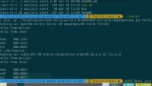
Honourable mentions:
asdf: nvm + pyenv+ rbenv + SDKMAN + … . Install and manage versions for all your cli tools. Go watch my talk ⇨
bat: “better” cat with syntax highlighting, Git Integration, automatic paging, etc
fd: “better”, faster, saner alternative to find written in Rust
ripgrep: “better”, faster”, saner alternative to grep written in Rust
https://www.youtube.com/watch?v=6NNbqDTSFD0&t=646s

Slide 13

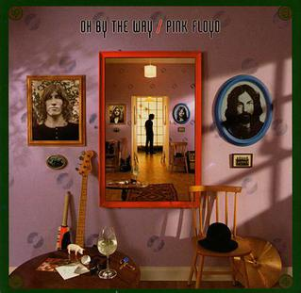
Oh, by the Way
Getting all of this to work can take some time
It’s a hobby like any other
Make sure to keep your files in version control
Take some time to steal ideas from get inspired by other people’s dotfile repositories.
I avoid text editors as much as I can but…
When I need an editor I use neovim:
… and vim-plug

Slide 14






Questions?
https://www.linkedin.com/in/aaccioly
https://stackoverflow.com/users/664577
https://a.accioly.7rtc.com
a.accioly at protonmail.com
Putting together the perfect terminal experience © 2021 by Anthony Accioly is licensed under
CC BY-SA 4.0

